Slide 1
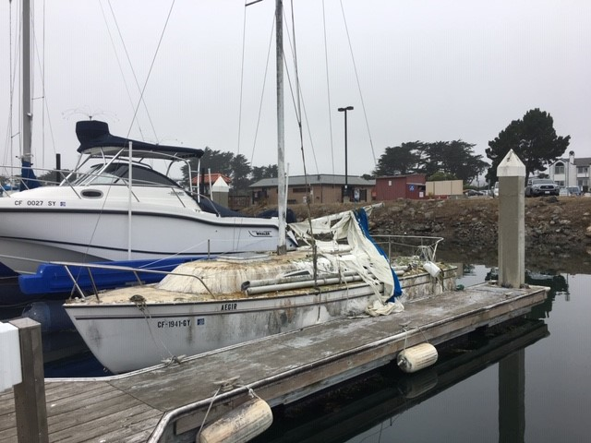
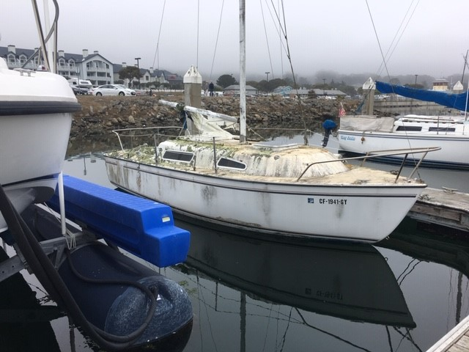
Pillar Point Harbor Lien Sale Wednesday, August 21st @11:00 AM One Johnson Pier Half Moon Bay, Ca 94019 Walk through is at 10:00 AM day of Auction Pre-auction walkthrough: Tuesday, February 27, 2018 between 10:00 AM and 11:00 AM
1979, 23ft
$1,000 Cash/Cashier’s check deposit due to Auction
Bidding starts at $1,000
With three day vessel removal contingency
Complete conditions of sale available at Harbormaster office
No proxy buyers allowed.

